Slide 1

Independent Study Update: MMTN Week 6
Karthik 2021.11.18
AMLL

Slide 2
Overview
Your suggestions on last week’s update
k inverse models

Slide 3
Geometry Exploration
Log vs sqrt color scale – color makes much more sense here

Slide 4
Geometry Exploration
Per Ben’s suggestion, multiply weight of boundary in error by 100 – solved issues with [-1, 1] domain
See below for examples of k > 2 (consistent across 40 trials)

Slide 5
Geometry Exploration
In areas of overlap different manifolds seem kind of similar but not exactly the same (except for one case)

Slide 6
Geometry Exploration
Errors with expected y values
Individual errors on next slide
Too dense to gather anything

Slide 7
Geometry Exploration

Slide 8
Multiple values of k
10 trials for k = 1, 2, 3, 4 inverse models
Mean error clearly goes down in exactly expected pattern
Still a very noisy error distribution

Slide 9
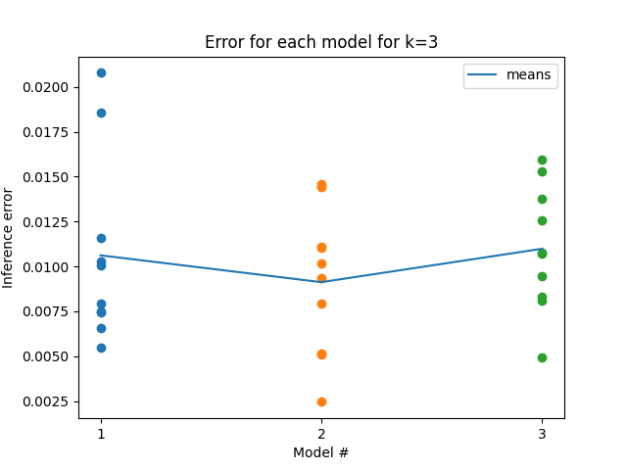
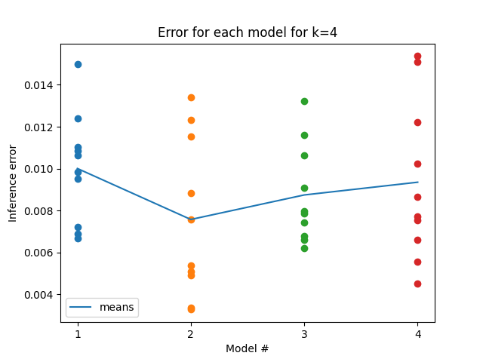
Multiple values of k
Was curious to see if each subsequent model’s inference error in a given set was increasing due to being pushed away from existing models
Doesn’t appear to be the case – seems like a good thing?

